Slide 1

DATA ANALYTICS BOOTCAMP · IRONHACK
Predicting Iron Concentrate Quality
Adriana Alves

Slide 2


01
THE QUESTION
Can process sensors predict
the final product quality?
A flotation plant separates iron from silica. The purity of the output is confirmed by lab sampling, which can takes hours. The process sensors, meanwhile, record continuously.
WHY IT MATTERS
$1.50–$2.50
price swing per tonne for every 1% of Fe grade
If sensor data could estimate purity in near real time, operators would see quality slipping long before the lab confirms it.
+2% productivity
mill productivity gain per 1% increase in grade
Notes:
We had 6 months of hourly sensor data from a flotation processing plant. The question was: can we use the data the plant is already collecting to predict iron concentrate grade in near real-time — without waiting for the lab?

Slide 3

02
THE FEATURE ENGINEERING
737,453
~4,000
116
3 models
raw sensor readings
logged every 20 seconds
hourly samples after
aggregation
engineered features
simple to complex:
tree, bagging, boosting
WHAT WENT INTO THE 116 FEATURES
Hourly aggregates
Lag & rolling windows
Time features
mean, std, min, max of every sensor
values from 1–3h back + 3h rolling means
hour, month
KEY DECISION Split chronologically, never randomly. A random split would let the model train on the future. Validation used TimeSeriesSplit, 7 folds.
Notes:
- Iron and silica content in the ore feed
- Reagent flows — starch and amina
- Ore pulp pH, density and flow rate
- Airflow and flotation level across 7 columns
- Lag features capturing what conditions were 1 and 3 hours ago
- Rolling averages over 3-hour windows
The target variable is iron concentrate percentage — typically ranging between 65 and 68%.
Why we didn't split the data randomly
This is a time series — the order matters. Randomly shuffling the data would let the model train on future readings to predict the past, which is data leakage. In a real plant, you never have future data available.
We split the data chronologically — train on the past, test on what comes after. For cross-validation, we used TimeSeriesSplit with 7 folds, which we tested against 3 and 5 folds and found to be the most stable for this dataset size.

Slide 4

03
THE FIRST (GOOD) RESULT
A suspiciously good score…
One feature was doing 80% of the work
FIRST MODEL · TEST R²
0.51
% silica concentrate was flagged the dominant predictor by a wide margin.
WHY? Silica is measured on the same final product, at the same moment, as iron concentrate. The model wasn't predicting quality.
REJECTED
not a real result
Decision: remove it, and find out what the process variables can really do.

Slide 5
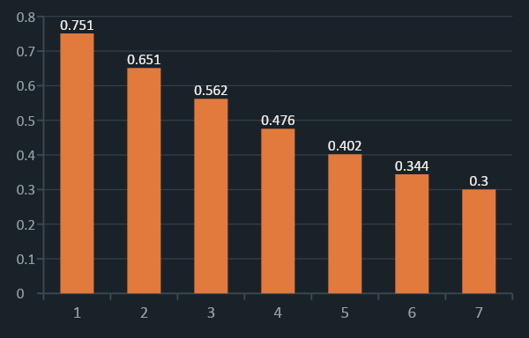
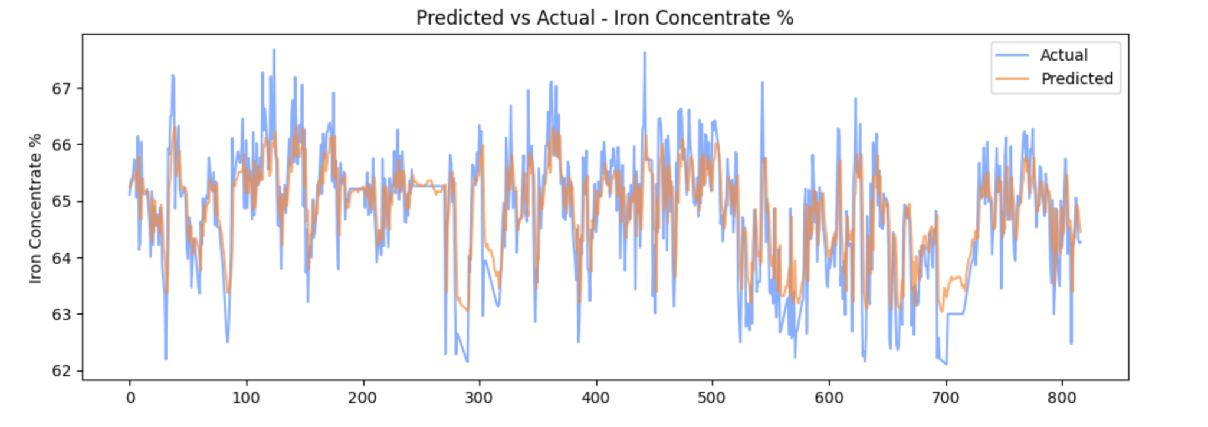
05
THE BREAKTHROUGH
Removed the real leak and add the best predictor
HOW IRON GRADE CORRELATES WITH ITS OWN PAST
If the target moves slowly, the most recent lab result is powerful information. It was the feature the pipeline was missing.
Lag from current hour → correlation decays but stays strong at 1–3 hours

Slide 6
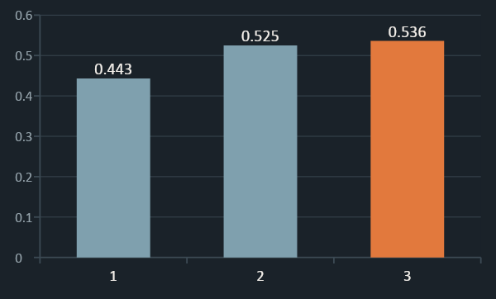
06
THE HONEST RESULT
Now we’re talking
TEST R² — FINAL MODELS
WINNER · TUNED XGBOOST
0.536
Test R²
0.563
Mean absolute
error (% Fe)
Predictions land within ~0.56 percentage points of the lab value, on average, and CV and test scores agree closely.
Decision Tree (baseline), Random Forest (bagging) and XGBoost (boosting), all tuned with GridSearchCV under TimeSeriesSplit. Tuning is what moved XGBoost ahead of Random Forest.
Notes:
In practice, that means when the plant is producing 66.5% iron concentrate, the model's prediction is typically between 65.9% and 67.1%. Given that iron concentrate quality is influenced by ore feed variability, microscopic mineralogy, and equipment state that no sensor fully captures, a 54% R² is consistent with what industrial ML systems achieve on this type of problem.
The CV and test scores are close — 0.54 and 0.56 — which tells us the model is not memorising the training data. It generalises honestly to unseen time periods.

Slide 7

07
WHAT IT MEANS
Findings
What was proved
How the model earns its place
Caught and removed data leakage that inflated the first score
Traced the weak signal to a lab-sampled, slow-moving target
Built an honest model: tuned XGBoost at R² 0.536
Gives a near-real-time grade estimate between slow lab samples
Can flag quality drift early enough for operators to react
A working pipeline and baseline, ready to extend
Notes:
The model predicts iron concentrate grade from live sensor readings. As long as the plant's instruments are running, the model can predict quality in near real-time — and can simulate what would happen if operators changed specific process variables. This gives the technical team both a monitoring tool and a decision support tool."
Instead of waiting for a lab result that comes back hours later, the model can use the live sensor readings that are available in real time — airflow, pH, reagent dosage, feed grade — and give an immediate estimate of what the concentrate grade likely is right now.
In the iron ore industry, a difference of even 0.5 to 1 percentage point in concentrate grade has direct commercial impact — it affects the price per tonne the product commands, blending decisions, and whether a shipment meets contract specifications. Catching a drop in quality hours earlier than a lab result allows operators to intervene before tonnage is lost.

Slide 8

08
CONCLUSION
Limitations
Where the data falls short
What would move it forward
Target is lab-sampled. Frozen ~94% of hours.
Process variables correlate only weakly with grade on their own
The test period drifts to a lower average grade than training
Higher-frequency lab sampling to expose true process dynamics
Predicting silica concentrate as a complementary target

Slide 9
Thank you for your attention!
Predicting Iron Concentrate Quality (Machine Learning Project)
Team: Adriana Alves

